Slide 1

Computational Framework for Understanding Microbial Pathogenesis and Antimicrobial Resistance (AMR)
Molecular Biology and Basic Cellular Physiology (24AIM112 )
Ethics, Innovative Research, Businesses & IPR (24AIM115 )
RAGUL U. - CB.AI.U4AIM24036
RAMKUMAR R. - CB.AI.U4AIM24033
SHWETHA P. - CB.AI.U4AIM24042
PRAGALYA M. - CB.AI.U4AIM24032

Slide 2
Introduction
Antimicrobial Resistance (AMR):
AMR is when microbes resist drugs, making infections harder to treat.
Understanding the genetic mechanisms behind AMR is crucial for developing effective prevention and treatment strategies.
At the same time, understanding protein virulence is crucial for identifying pathogenic factors that contribute to disease progression
2

Slide 3
Objective
Predict Antimicrobial Resistance (AMR)
Prediction of Virulence factor in Protein
Apply Machine Learning for Predictions
UI for easy use
Provide a Scalable and Cost-Effective Approach
3

Slide 4
PROGRESS
Data collected
Collection of the data :
Gene sequence
Protein sequence
Sources:
NCBI ( National Centre for Biotechnology Information) for gene sequences
UniProt for protein sequences
4

Slide 5
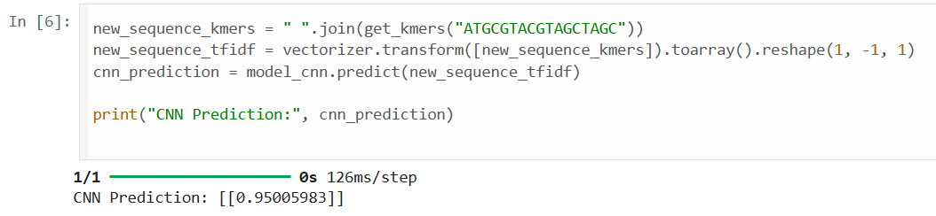
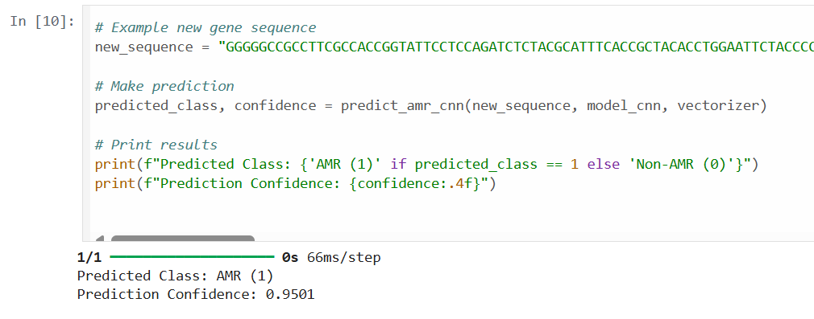
AMR Prediction using CNN (K-mer + TF-IDF)
5

Slide 6
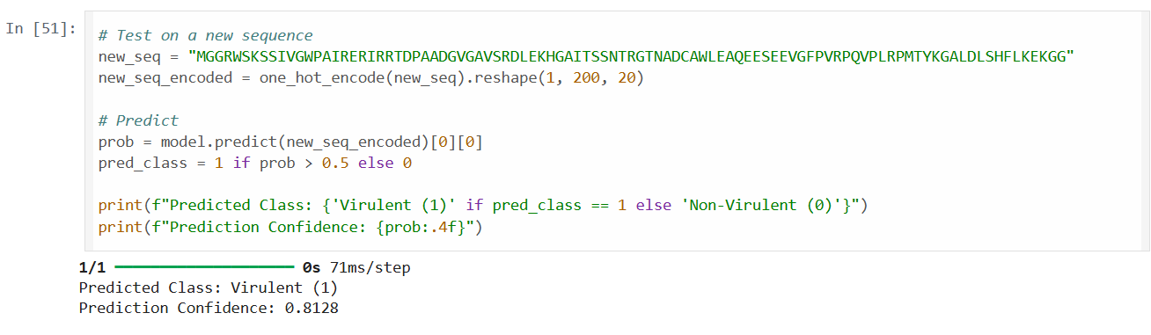
Protein virulence prediction
MODEL USED | ACCURACY | Feature of the model
ProtBert + Random Forest | 92% | Learns relationship between sequences
CNN + BiLSTM | 93% | Captures the structural patterns
Fig. Output obtained from the final model (CNN+BiLSTM)
6

Slide 7
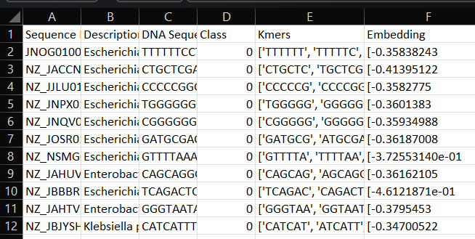
Problems faced
Class imbalance in dataset
Extracting gene and protein sequences from NCBI (AMR) & UniProt (Virulence) was time-consuming and complex .The dataset had a skewed distribution (more AMR/Virulent sequences than non-AMR/non-virulent ones)
1319 -Virulence protein sequence,
807-Non Virulence protein sequences
480 -AMR gene sequence,
124- Non AMR gene sequences
Overfitting in CNN Models
Initial models trained on gene and protein sequences using CNNs showed high accuracy but suffered from overfitting due to class imbalance.
Switched from raw sequence input to Word2Vec embeddings to generalize better
7

Slide 8
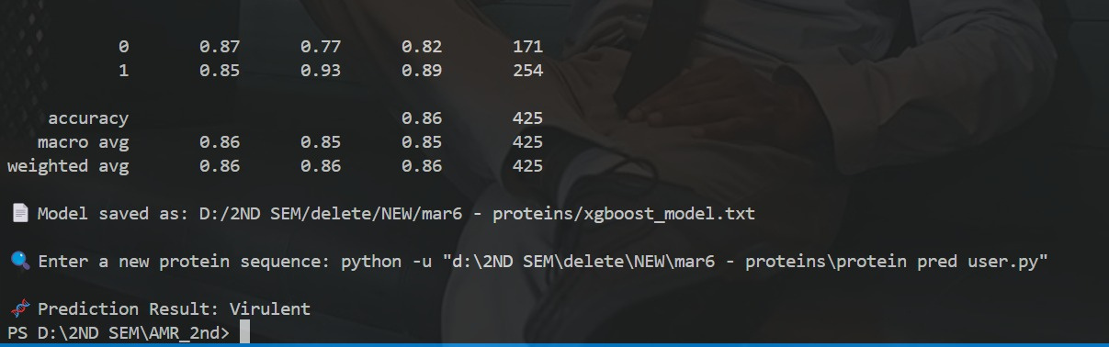
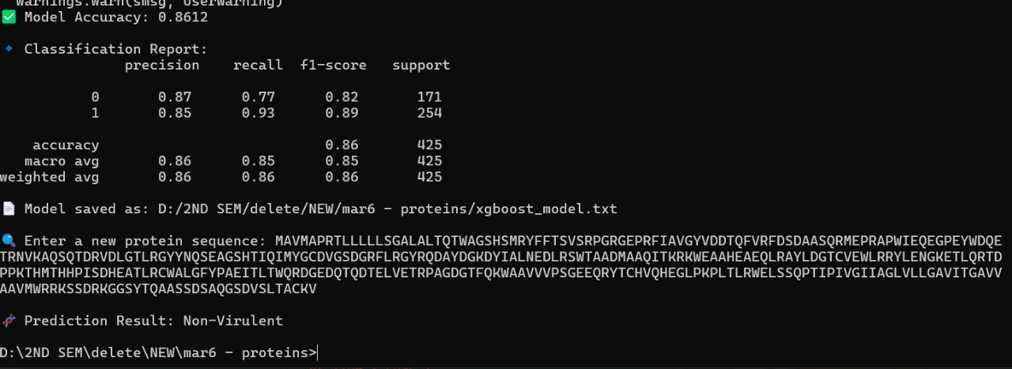
XG-BOOST model trained for Virulent Prediction
8

Slide 9
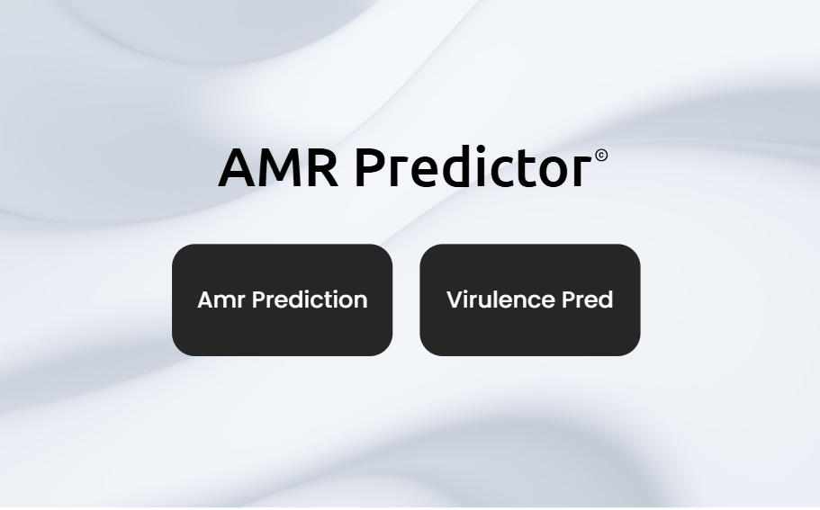
User - Interface
Features :
AMR prediction
Virulence Pred
KEGG
PDB - Search
9

Slide 10

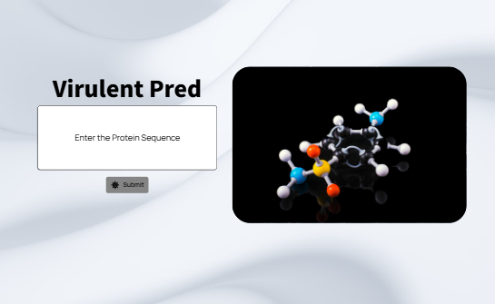
User - Interface
10

Slide 11
FUTURE WORK:
Further classes of resistance gene will be added for better prediction and understanding.
Incorporating larger datasets to improve model generalizability.
Including more bacterial strains, viral genomes, and fungal pathogens.
Using ML to forecast the emergence of new resistance genes.
UI interface for integration of amr prediction with virulence prediction for better access.
11

Slide 12
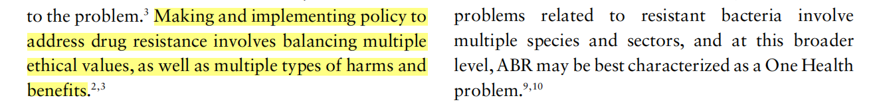
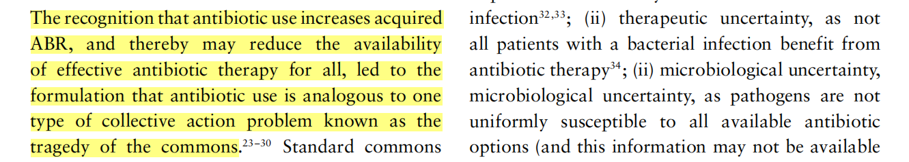
PAPER 1 - Ethics and antibiotic resistance
The ethical challenges posed by antibiotic resistance, emphasizing the severe and unevenly distributed health consequences. It critiques common frameworks like patient responsibility, the tragedy of the commons, and antibiotic stewardship, highlighting their limitations
Responsibility and Accountability
Public Health vs. Individual Freedom
12

Slide 13
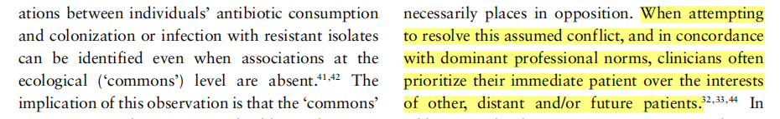
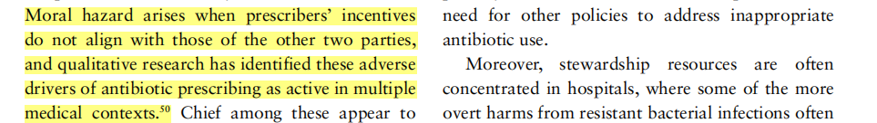
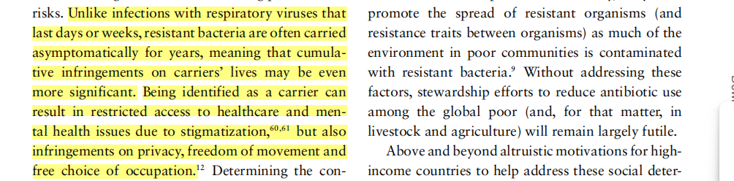
Conflicts of Interest in Healthcare
Autonomy and Individual Rights
13

Slide 14
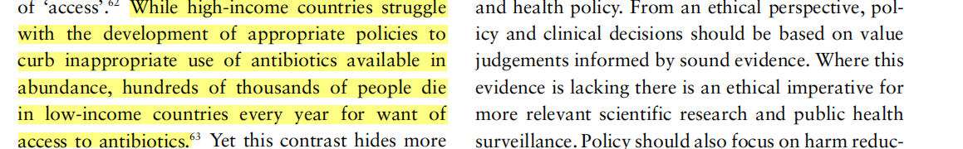
Justice and Fairness
14

Slide 15
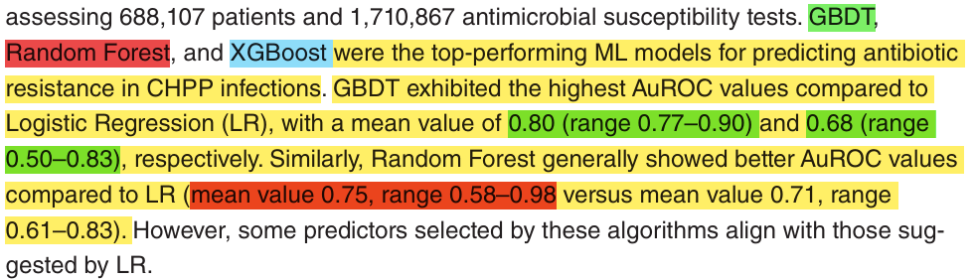
PAPER 2 - Machine learning for predicting antimicrobial resistance in
critical and high-priority pathogens ( Carlos, Daniel, Sergio )
Published 25 Feb 2025
They found that Gradient Boosted Decision Trees (GBDT), Random Forest, and XGBoost were the top-performing ML models.
15

Slide 16
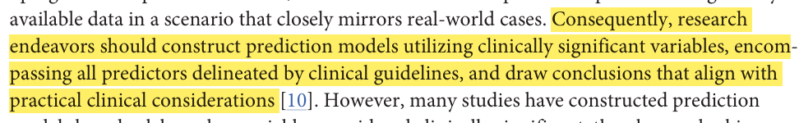
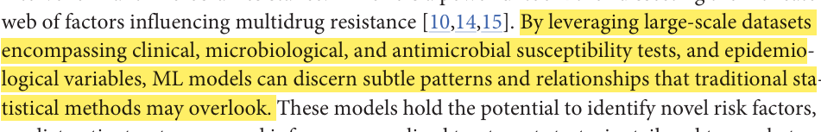
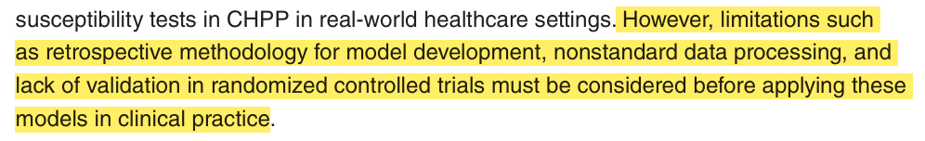
ETHICS
BIAS
Data Privacy and Security
Responsible Use of Technology
16

Slide 17
PAPER 3 - Artificial intelligence in predicting pathogenic microorganisms’ antimicrobial resistance: challenges, progress, and prospects
Author : Yan Li, Xiaoyan Cui, Xiaoyan Yang, Guangqia Liu ,Juan Zhang
Published : 01 November 2024
Objective :
1. This paper reviews the latest advancements in AI and ML for predicting antimicrobial resistance in pathogenic microorganisms.
2. highlights the main AI and ML models used in resistance prediction,
3. Finally the paper discuss about the new perspectives and solutions for research into microbial resistance through algorithm optimization, dataset expansion, and interdisciplinary collaboration.
17

Slide 18
Case Study
PATENT: GLYCOMIMETICS TO INHIBIT PATHOGEN-HOST INTERACTIONS
(US 9,605,014 B2)
Date of Patent: Mar. 28, 2017
The patent US9605014B2 describes glycomimetic compounds designed to inhibit pathogen-host interactions
A glycomimetic as described herein may be used to impregnate filters, masks, and clothing or any combination thereof in prophylactic strategies to reduce transmission and inhibit the binding of any of a variety of pathogens to their target.
18

